Slide 1
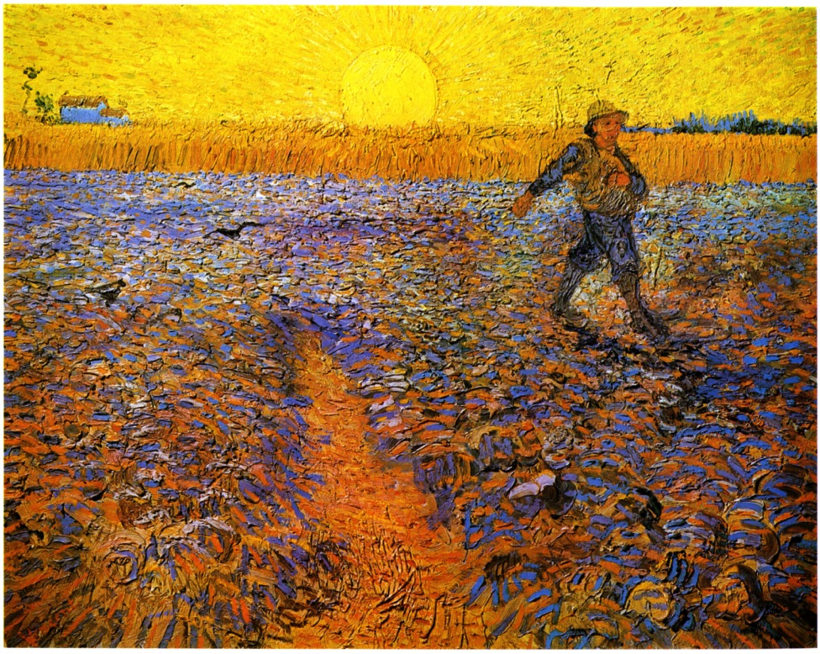
MCtwo 2016
Soul Food to Go – Care of the Missionary Soul
Outposts of Normality
Nancy Blanski VENITE Ministries

Slide 3
¹ “God is our refuge and strength, A very present help in trouble. ² Therefore we will not fear, though the earth should change And though the mountains slip into the heart of the sea; ³ Though its waters roar and foam, Though the mountains quake at its swelling pride.
⁴ There is a river whose streams make glad the city of God, The holy dwelling places of the Most High. ⁵ God is in the midst of her, she will not be moved; God will help her when morning dawns. ⁶ The nations made an uproar, the kingdoms tottered; He raised His voice, the earth melted. ⁷ The Lord of hosts is with us; The God of Jacob is our stronghold.
⁸ Come, behold the works of the Lord, Who has wrought desolations in the earth. ⁹ He makes wars to cease to the end of the earth; He breaks the bow and cuts the spear in two; He burns the chariots with fire. ¹⁰ “Cease striving (be still) and know that I am God; I will be exalted among the nations, I will be exalted in the earth.” ¹¹ The Lord of hosts is with us; The God of Jacob is our stronghold.”
Psalm 46

Slide 4
“There is a river whose streams make glad the city of God”
I. All is not well with the world
“ For we know that the whole creation groans and suffers the pains of childbirth together until now. And not only this, but also we ourselves, having the first fruits of the Spirit, even we ourselves groan within ourselves, waiting eagerly for our adoption as sons, the redemption of our body.”
Romans 8:22-23
Strangers and Aliens in this World
“All these died in faith, without receiving the promises, but having seen them and having welcomed them from a distance, and having confessed that they were strangers and exiles on the earth.”
Hebrews 11:13

Slide 5
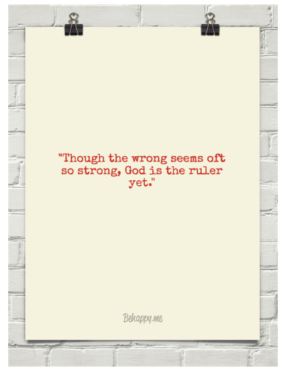
Our Citizenship is in Heaven!
“For our citizenship is in heaven, from which also we eagerly wait for a Savior, the Lord Jesus Christ…”
Philippians 3:20
“This is my Father's world. O let me ne'er forget That though the wrong seems oft so strong, God is the ruler yet.”

Slide 6
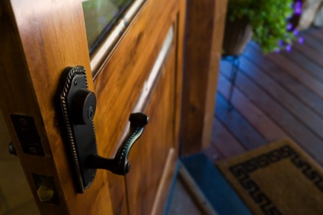
II. The Call: Create Outposts of Normality in Our World
Outpost
- a small military camp or position at some distance from the main force,
- a remote part of a country or empire.
“The world, besides being quite mad, is now an unspeakably drab, tawdry, and lonely place. Build outposts of normality.”
Anthony Esolen

Slide 7
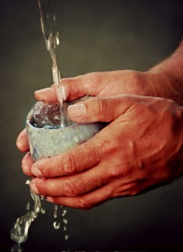
…Give permission to practice the slow work of being an
Outpost of Normality.
“The man who is wise, therefore, will see his life as more like a reservoir than a canal. The canal simultaneously pours out what it receives; the reservoir retains the water till it is filled, then discharges the overflow without loss to itself ... Today there are many in the Church who act like canals, the reservoirs are far too rare ... You too must learn to await this fullness before pouring out your gifts, do not try to be more generous than God.” ― Bernard of Clairvaux 12th C .

Slide 8
“Blessed is the man who trusts in the Lord And whose trust is the Lord. For he will be like a tree planted by the water, That extends its roots by a stream And will not fear when the heat comes; But its leaves will be green, And it will not be anxious in a year of drought Nor cease to yield fruit.”
-Jeremiah 17:7-8
“I get the feeling we are a tired generation.”
- Gordon MacDonald

Slide 9
Jesus – a model for what it means to be an Outpost of Normality.
He broke bread and blessed it
He touched the sick
He interacted with friends and relatives
He discussed farming – watching soil and seeds sprout and grow
He spoke of being a landlord
He told us about losing and finding things
He ate with friends, sinners and tax collectors
He prayed privately and publically
He welcomed guests
He loved people

Slide 10
Missionaries – models for being Outposts
• Mary Slessor
Protected children and women in Nigeria
• J. Hudson Taylor
Responsible for bringing over 800 missionaries to China who shared the Gospel through starting 125 schools
• Amy Carmichael
Opened an orphanage in India, rescued young girls from forced prostitution
• George Müller
Prayer warrior who started orphanages - took care of more than 10,000 children

Slide 11
…Give permission to practice the slow work of being an
Outpost of Normality.
III. Practicing Being an Outpost of Normality
– Some ways to Begin
• found in Scripture
• go across cultural lines
• can be practiced and recognized everywhere
• can be individually tailored
Three Spiritual Practices
- Slowing Down
- Enjoying Home
- Sharing Meals
Above all, trust in the slow work of God, our loving vine-dresser.”
- Pierre Teilhard de Chardin

Slide 12
Creating and Pursuing
1. Encourage our Global Workers to take the time and resources to create homes and workplaces that reflect Jesus and the rhythms He taught.
In the midst of our Missionaries doing their work, make sure they have time to routinely pursue these spiritual practices that support and enhance their labor.
“The discovery of God lies in the daily and the ordinary, not in the spectacular and the heroic. If we cannot find God in the routines of home and shop, then we will not find him at all.”
- Richard Foster

Slide 14
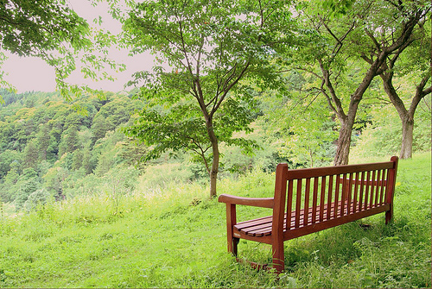
Slowing Down and Practicing Sabbath
“How much did you get done?”
vs.
“Is your love for God and others growing?”
“Success is the world’s criterion of merit; fidelity is God’s.”
Charles Robinson

Slide 15
“The first step toward an unhurried life is naming chronic hurry for what it is—sin. Chronic hurry is an attitude of the heart that peace will only come when I’ve completed my to-do list. Chronic hurry is a spiritual matter because it’s deeply rooted in my ego and self-importance. It’s rooted in a pattern of ignoring and rejecting the limitations that I have as a human being who needs times of silence, solitude, and rest . . .
. . . Yet chronic hurry is very different from holy urgency. Repentance from chronic hurry does not mean an overcorrection into laziness. Sloth is a sin, too. Learning the holy rhythm of mission and Sabbath is the easy yoke of Jesus’ kingdom we’re meant to assume.”
- Jack King

Slide 16
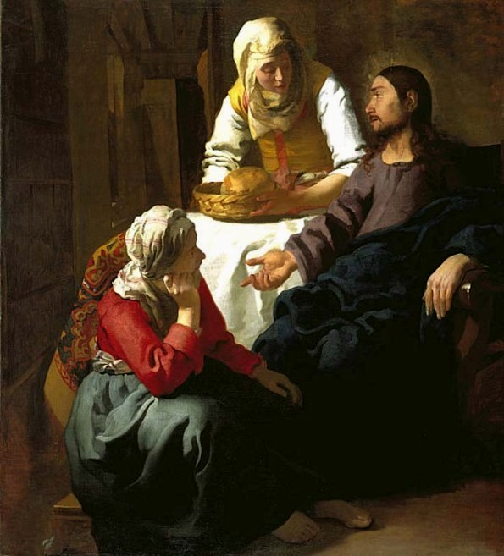
Vermeer – Mary at the Feet of Jesus - 1655

Slide 17
…Give permission to practice the slow work of being an
Outpost of Normality.
“It is a sign forever between me and the people of Israel that in six days the Lord made heaven and earth, and on the seventh day he rested and was refreshed!”
- Exodus 31:17
“When we become a Sabbath people, we give one of the most compelling witnesses to the world that we worship a God who desires our collective joy and good.”
- N. Wirzba
“Hurry is not of the devil; hurry is the devil.”
- Carl Jung

Slide 18
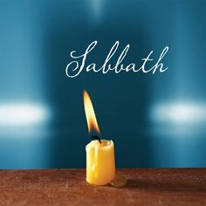
“[Sabbath] sets us free from bondage to our own efforts. Only in this way can we come to the power and joy of a radiant life in ministry, a blessing to all we touch. And yet Sabbath is almost totally absent from the existence of contemporary Christians and their ministers.”
Dallas Willard, The Great Omission

Slide 19
Bilbo:
“Look, I know you doubt me. I know you always have.
And you’re right... I often think of Bag End.
I miss my books, and my armchair, and my garden.
See, that’s where I belong, that’s home.
That’s why I came back...cause you don’t have one, a home.
It was taken from you.
But I will help you take it back if I can.”
“The way you live your days is the way you live your life.”
Annie Dillard

Slide 20
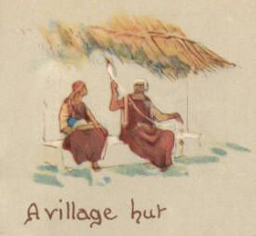
Enjoying Home
Lilias Trotter – Algeria

Slide 21
Hygge: A heart-warming lesson from Denmark
- Justin Parkinson BBC News Magazine
“Sitting by the fire on a cold night, wearing a woolly jumper, while drinking mulled wine and stroking a dog - probably surrounded by candles. That's definitely "hygge".
Eating home-made cinnamon pastries ... Tea served in a china set. Family get-togethers at Christmas. They're all hygge too.
The Danish word, pronounced "hoo-ga", is usually translated into English as "cosiness". But it's much more than that, say its aficionados – it’s an entire attitude to life that helps Denmark to vie with Switzerland and Iceland to be the world's happiest country. . .The idea is to relax and feel as at-home as possible . . .”
“The rest of the world seems to be slowly waking up to what Danes have been wise to for generations - that having a relaxed, cosy time with friends and family, often with coffee, cake or beer, can be good for the soul.”
- Helen Russell

Slide 22
“In the midst of all the violence and corruption of the world God invites us today to create new places of belonging, places of sharing, of peace and of kindness, places where no one needs to define himself or herself; places where each one is loved and accepted with one’s own fragility, abilities and disabilities.”
- Jean Vanier
Founder of L’Arche Homes
"Now we know that if the earthly tent [physical body] we live in is destroyed, we have a building from God, an eternal house in heaven, not built by human hands. Meanwhile we groan, longing to be clothed with our heavenly dwelling."
- 2 Cor. 5:1-2

Slide 23
“Basically, it is because we are made in the image of God. And the image is always attracted to the Original, the Archetype. We were made for God. When God created us in His image, He endowed us with a mind that we may come to know Him. In addition to a mind, He gave us a heart to desire Him, to long for Him, to crave Him and run after Him, to be homesick for Him.”
- Anthony Coniaris
“Your home is as unique as your personality and no matter what your home is like, Christ lives there.”
- Joann Thompson

Slide 24
“If I find in myself a desire which no experience in this world can satisfy, the most probable explanation is that I was made for another world”
- C.S. Lewis
“The meaning and goal of life for each one of us is to respond to this homing instinct within us and go home to God. The difference between us humans and all other creatures in the world is that they do it automatically. We however, have a choice.”
- Anthony Coniaris
“Unless the Lord builds the house, They labor in vain who build it;
… It is vain for you to rise up early, To retire late, To eat the bread of painful labors; For He gives to His beloved even in his sleep.”
- Psalm 127:1-2

Slide 25
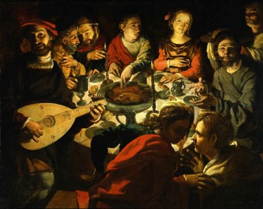
…Give permission to practice the slow work of being an
Outpost of Normality.
Sharing Meals
Jesus used meals to:
- Be with outcasts, sinners, the rich and poor, friends and strangers
- Call disciples
- Challenge the religious laws
- Perform miracles
- Challenge social norms
- Forgive
- Offer fellowship, hospitality, and celebration
- Institute the Lord’s Supper
“Time is God’s good creation, and mealtime is God’s metronome designed to bind our busy lives to the Father.”
- Joanne Thompson

Slide 26
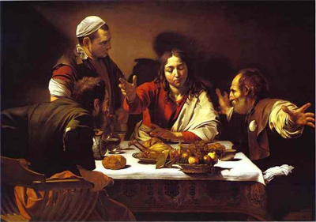
After His resurrection He:
- Broke bread with two disciples on their way to Emmaus
- Ate with disciples at the beach
- Those of us who ate and drank with him after he arose
“A meal of bread and water in contented peace is better than a banquet spiced with quarrels.”
- Proverbs 17:1
The Message

Slide 27
“Because sharing a meal helps us to view those of different races, genders, and socioeconomic backgrounds as more equal than they would in other social situations.”
- Eating Together, Alice Julier
“…sharing a family meal is good for the spirit, the brain and the health of all family members. Recent studies link regular family dinners with many behaviors that parents pray for: lower rates of substance abuse, teen pregnancy and depression, as well as higher grade-point averages and self-esteem”
- Anne Fishel, Professor of Psychology
Harvard Medical School

Slide 28
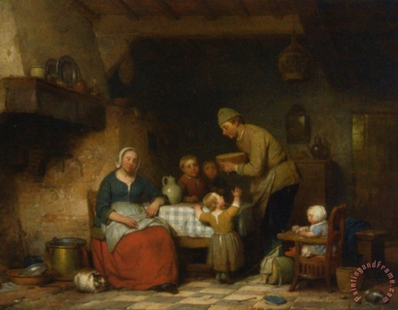
Take time to sit down and share meals with family (or team members) - often
Open their doors to share those meals with others – often
“…do not forget to entertain strangers, for by so doing some people have entertained angels without knowing it.”
Hebrews 13:2
“I have calmed myself and quieted my ambitions; I am like a weaned child with its mother; like a weaned child I am content.”
- Psalm 131:2

Slide 29
SMALL GROUPS
Slowing down/Sabbath • Enjoying Home • Sharing Meals
• How have you or a missionary you know benefited from these three spiritual habits?
• In a missions context, what is the relationship between:
- working for Christ (“Therefore go and make disciples of all
nations”)
and
- love for Christ (“but only one thing is necessary, for Mary has
chosen the good part…”)?
• What are your thoughts about encouraging your missionaries to pursue these three spiritual practices?
• What other outposts have you seen be successful?

Slide 30
How to Encourage Missionaries to Practice Being an
Outpost of Normality
1. Ask:
- How they are doing with these normal, everyday things
- How you can help them – what do they need from you that
could help them live from sitting at the feet of Jesus
- What drives them? What do they need to do to feel OK?
Listen to them about what their everyday life is like and pray for them
3. Introduce/encourage them to create a “Rule of Life”
4. Consider requiring “Sabbath” days and quarterly days away
Encourage them to play more often

Slide 31
How to Encourage our Missionaries to Practice Being an
Outpost of Normality
Encourage them to find (or nurture an existing) spiritual friendship. Someone who will listen to them, pray with them, pray for them on a regular basis
Consider providing a retreat for them in their country (or nearby)
Provide resources to aid them in becoming “reservoir rather than a canal”
Help provide resources that would bring peace to their home
Practice being an
Outpost of Normality yourself
“Ask where the good way is, and walk in it, and you will find rest for your souls.”
Jeremiah 6:16

Slide 32
MCtwo 2016
Soul Food to Go – Care of the Missionary Soul
Outposts of Normality
Nancy Blanski VENITE Ministries

