Slide 1
Ministry to your global workers
In tough places

Slide 2
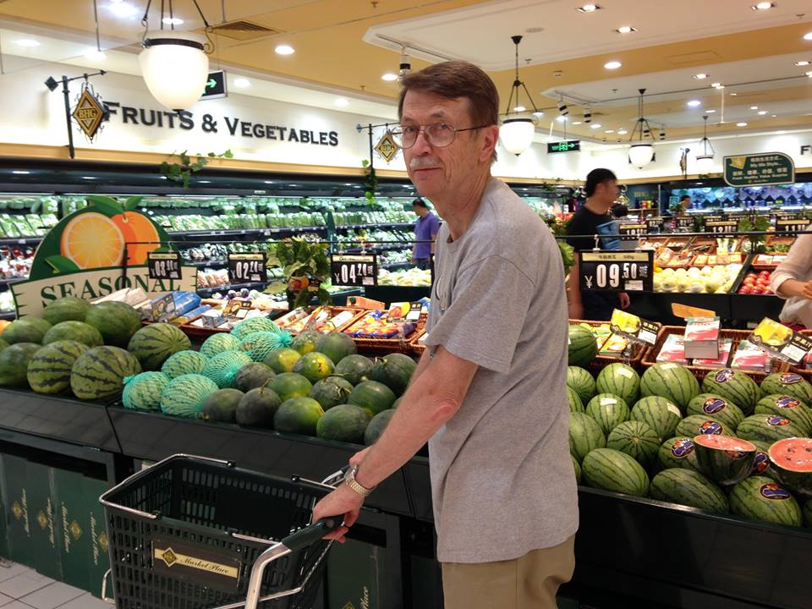
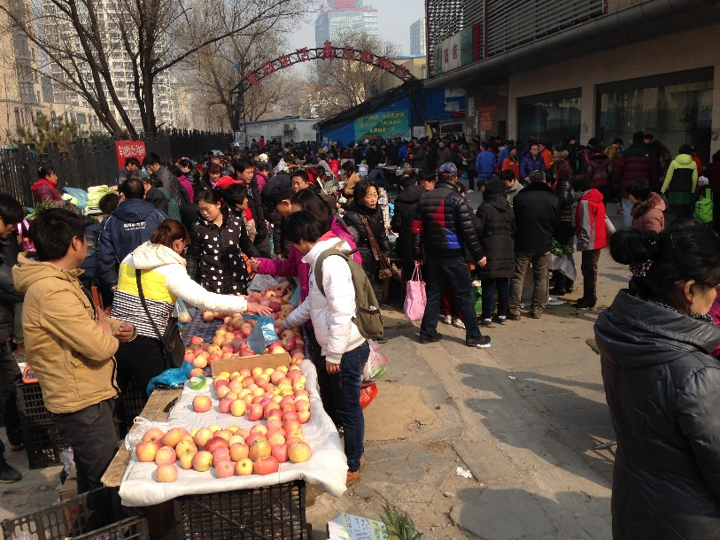
What is a tough place?
Anywhere that is not your home can be a tough place!!

Slide 3
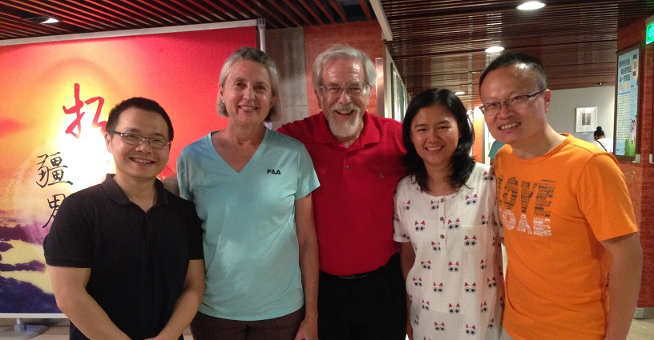
What is ‘tough?’
Marked by absence of softness and comfort
Very hard to influence
Life in a place that is far from all that is familiar

Slide 4
Why focus on global WOMEN?
There are far more women in missions than men
Here’s a formula: Men focus primarily on task Women focus on making life work – plus ministry and task.
If women aren’t functioning well, everything falls apart!

Slide 5
Time for you to talk!
Divide in to groups of four.
(If you came with others from your own church, you may want to work with them.)

Slide 6
Take the sheet
Turn to the side entitled “Questions to ask a cross-cultural worker”
These are the questions you will work from in your small group.
We will look at the other side later.

Slide 7
Learning by asking ???
Brainstorm categories of questions you could ask a cross-cultural worker.
What do you want to know?
What do you think they want you to know?
What do they want to be asked?

Slide 8
Asking the deeper questions
Look over questions on the handout and group them into categories.
How do they match up with the categories you determined before?
Can you spot any differences?

Slide 9
Asking questions ~ some caveats
There has to be a relationship and trust to ask deep questions. It may take time to get to that point.
Some questions are best asked in a one-on-one conversation while others can be asked in a group or committee meeting.

Slide 10
Asking questions ~ some caveats
Why do good questions minister to the soul of a cross-cultural worker?
Open ended questions allow the global worker to talk about what is important to them. You may not ever guess what is most important.

Slide 11
Asking questions ~ some caveats
Good questions allow you to learn how to support your global worker with more than $$$$.

Slide 12
Primary needs of women workers
To be spiritually mentored
To feel connected
To be known, understood, and prayed for
To have close friends
Time away from ministry/life responsibilities

Slide 13
Look at the questions again
Pick one and talk about where you think the conversation might go.
What other questions fit in the same category?
How would you respond to answers that show your worker has some real struggles in their life?

Slide 14
Who is responsible for care?
Global Worker
Sending church
Mission agency

Slide 15
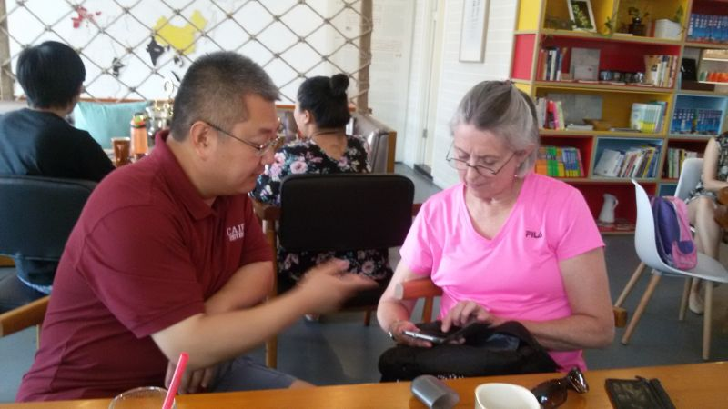
Feedback

Slide 16
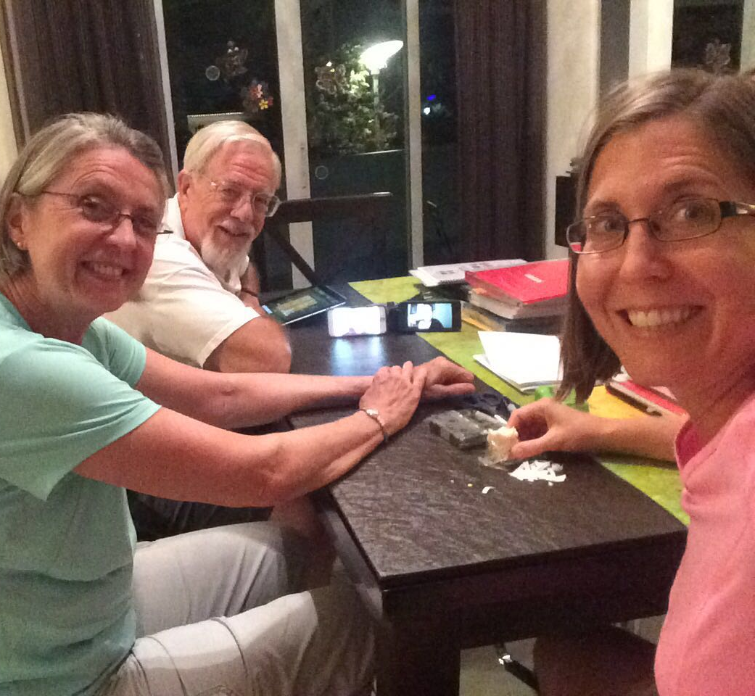
Asking questions
How can you use questions to care for your global workers when they are NOT with you?
What do you need to know?

Slide 17
Asking questions
Internet access?
Equipment?
Time zones?
Security concerns?

Slide 18
Recapping the other side
How can you be proactive rather than reactive?
Missionary Member Care Quiz

Slide 19
Next steps
In your group, discuss how you plan to use what you have learned. What do you need to change in caring for your global workers?

Slide 20
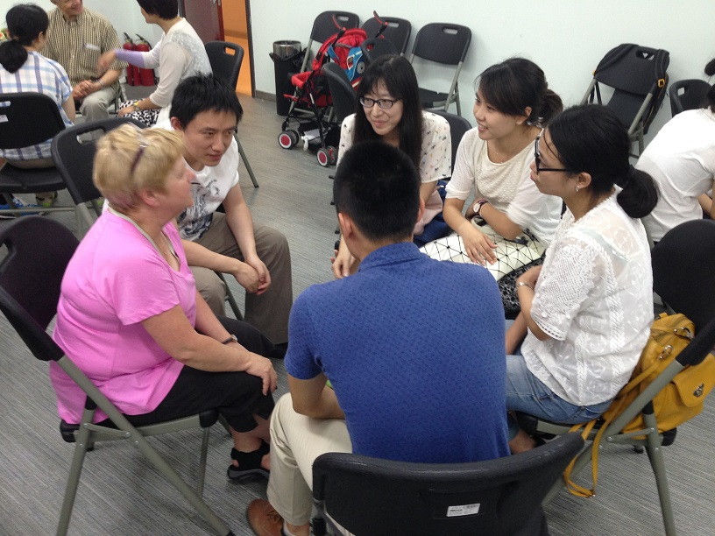
Feedback

